Slide 1
Optimizing Baltimore Police Dispatch Locations
Tom Hervieu, Jason Kolbush,
Chris Kwan

Slide 2
Background Info:
Baltimore has one of the highest shooting rates in the United States
As of April 8, 2017, there have been 232 homicide shootings, which is close to the third highest prior to the 344 homicides in 2015.
As of 2016, there are 2.8 million people living in Baltimore; so it’s the 21st largest metropolitan area in the country.
About 0.4% of the population is involved and/or impacted by a violent crime every year.

Slide 3
Goal and Data Set:
We will optimize the Baltimore Police Department dispatch locations for callers based on 1 million rows of data.
We hope this will result in quicker responses by police to callers, that may be in imminent danger where even seconds matter.
The data set is obtained from “Data.gov”, which has Baltimore's emergency and non-emergency calls from 911.
Why are we using this data set? It includes the specific locations (latitude and longitude coordinates) of where the calls were made, and the urgency of the call.

Slide 4

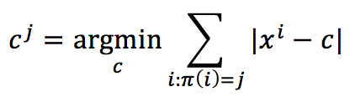
Algorithm: K-Means
Input: 1 million (Latitude, Longitude) coordinates, k = 200
Output: 164 clusterized dispatch coordinates (cluster centers)
Choose a random coordinate in data set as initial centroid.
While (center_moved):
Compare each location to updated centroid (using Manhattan distance) to see which coordinate is closer to the updated centroids (i.e. ) .
Update the centroids to new location (i.e. ).
End

Slide 5
Challenges:
Many of the given data, contains empty coordinates (46 were deleted), which indicates an error in calculating the centroids. This eliminated the clusters that were located on the bodies of water.
Running algorithm for 1 million rows on 200 clusters took 1-2 hours
The biggest challenge for our endeavour is using manhattan distance, which will not necessarily result in the shortest path from point A to point B.
This is due to the fact that roads may run diagonally, or there may be heavier traffic in certain areas.
Some clusters will contain more data points than others
This means that some dispatch centers need to be able to handle a higher call frequency than others

Slide 6
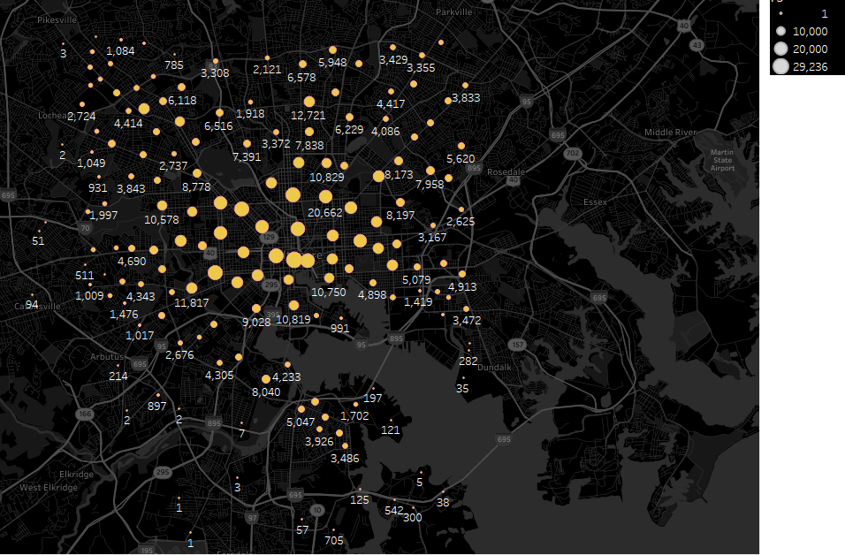
Results

Slide 7
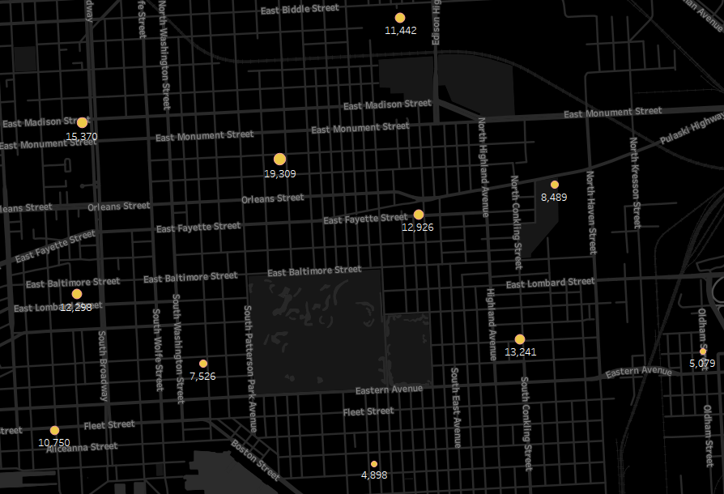

Slide 8
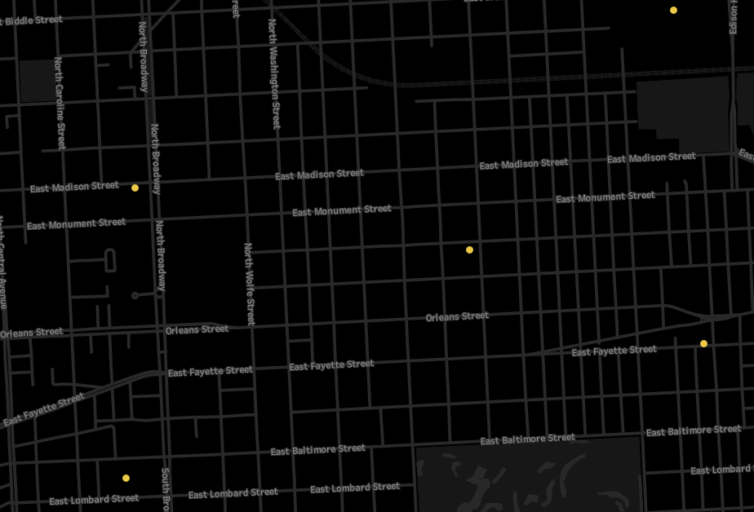

Slide 9
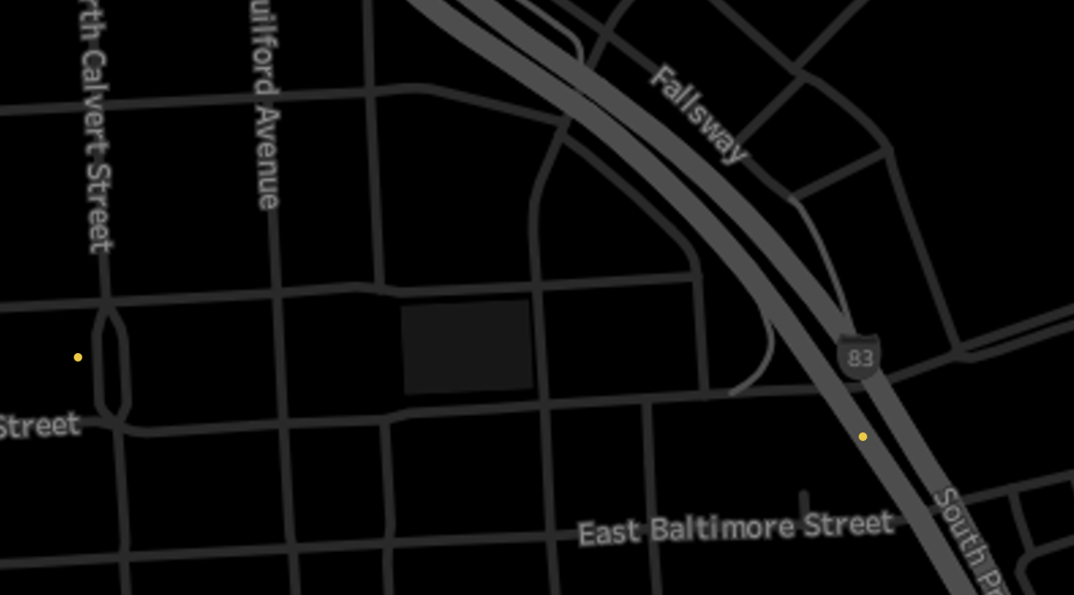

Slide 10
Implications
Compare police response time based on the usage of our optimal dispatch locations (would need to actually be used to test)
Also serves as a good model for both the police and the public to distinguish between the good and bad neighborhoods of Baltimore based on size and density of cluster centers.

Slide 11
References:
Data set: https://catalog.data.gov/dataset/calls-for-service
General Statistics: http://www.baltimorepolice.org/content/crime-statistics
Info: http://www.baltimoresun.com/news/maryland/baltimore-city/bs-md-ci-deadliest-year-20160101-story.html

Slide 12
Questions?

